Slide 1


Slide 2


https://meeting.tencent.com/download-center.html?from=1002

Slide 3
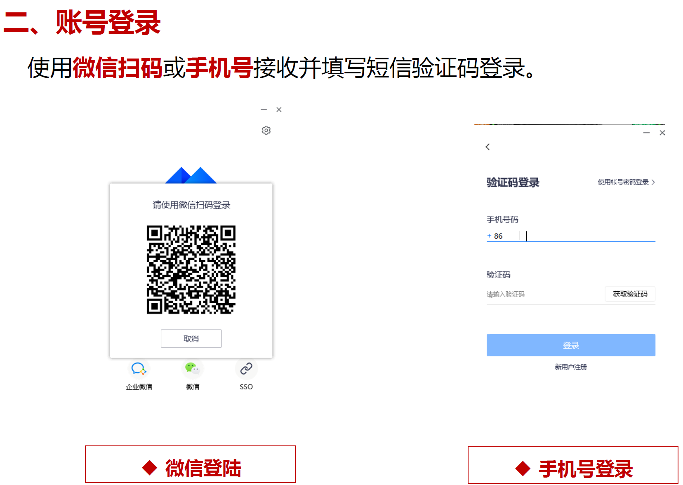

Slide 4
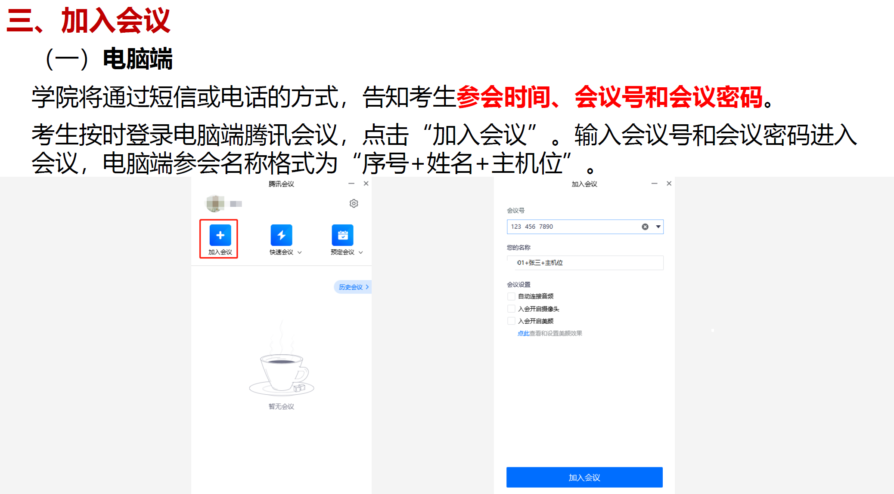

Slide 5
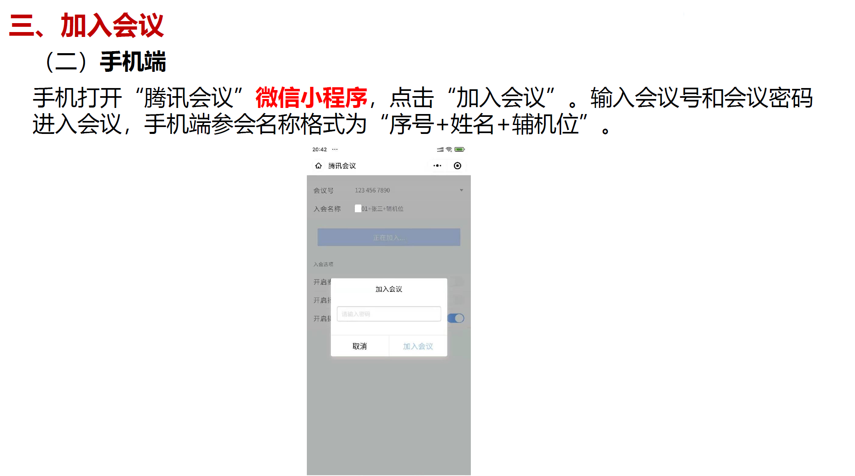

Slide 6
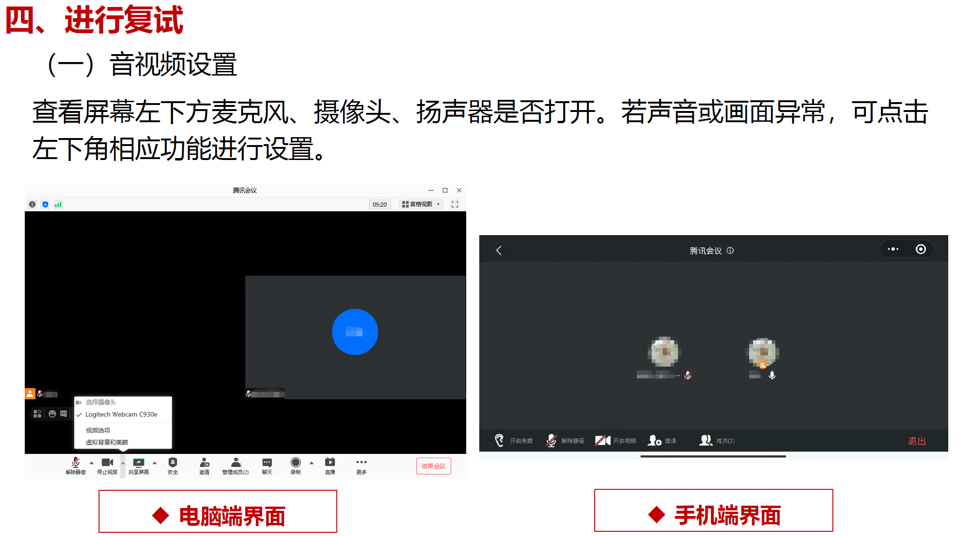

Slide 7
